Slide 1
Peer-2-Peer Marketplace:
Model-View-Template Architectural Design
Presenter: Samuel Debesai, CSSE
Advisor: Dr Arnold Lund
Sponsors: Mr. Mark Kochanski, Dr. Hazeline Asuncion
Quarter: Autumn 2021

Slide 2
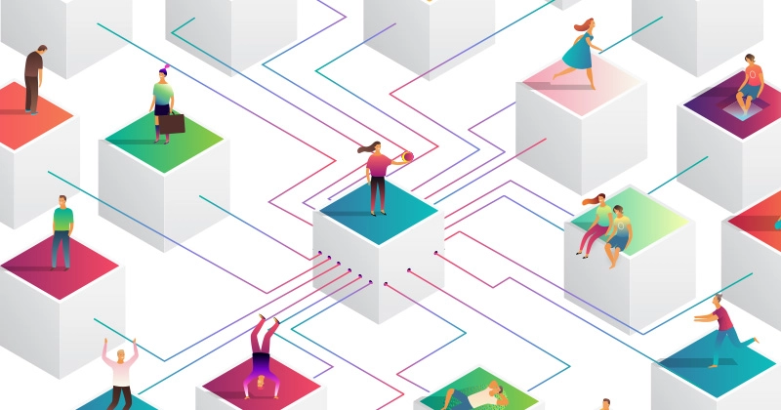
What is a Peer-2-Peer Marketplace?
A Peer-2-Peer Marketplace is an online platform where individual sellers can use a decentralized method to sell products to a potential target audience with a desired need.
The advantage of using a P2P marketplace enables the seller to minimize marketing costs and enter a new avenue for customer relations.
P2P is usually understood for the sole entity to engage with the system yet the concept of allowing pet owners to sell/buy items on an online platform isn't widely popularized.
This is why I will be engaging a domain specifically for animals, so people can find a way to discover many listings for a defined marketplace.

Slide 3
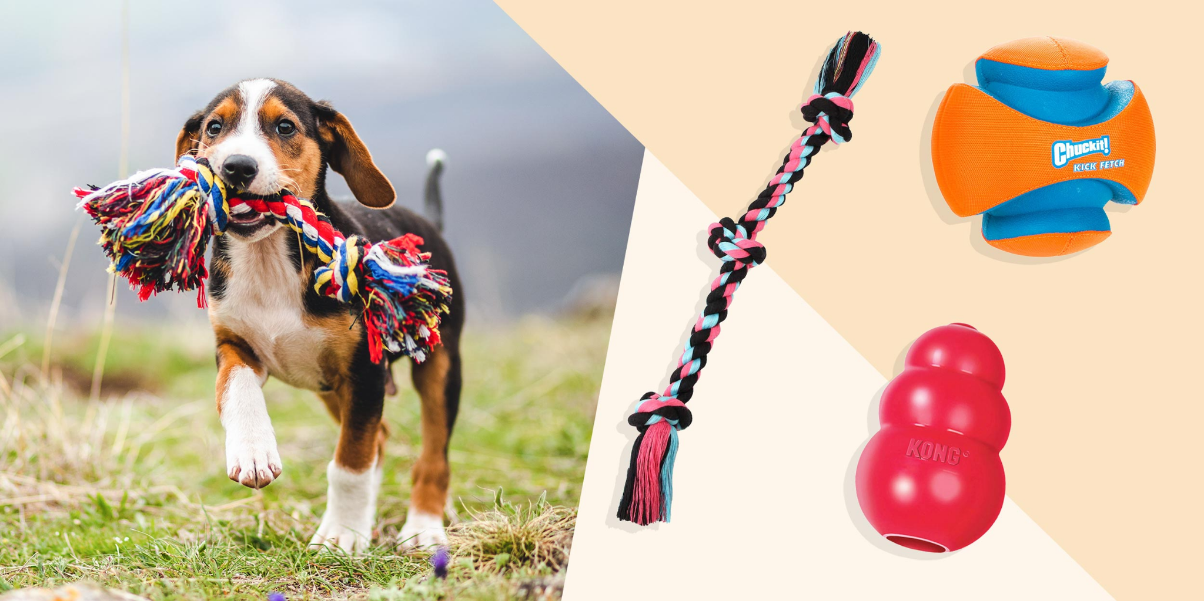
Introduction - Big Idea
“The plan is to build a website that can offer sellers and buyers the ability to trade amongst each other with animal products as the central focus of itemization. As a developer it is my focus to maintain a site that effectively allows the users to be able to administer their items, as well as ensuring all products reach their final destination.“

Slide 4
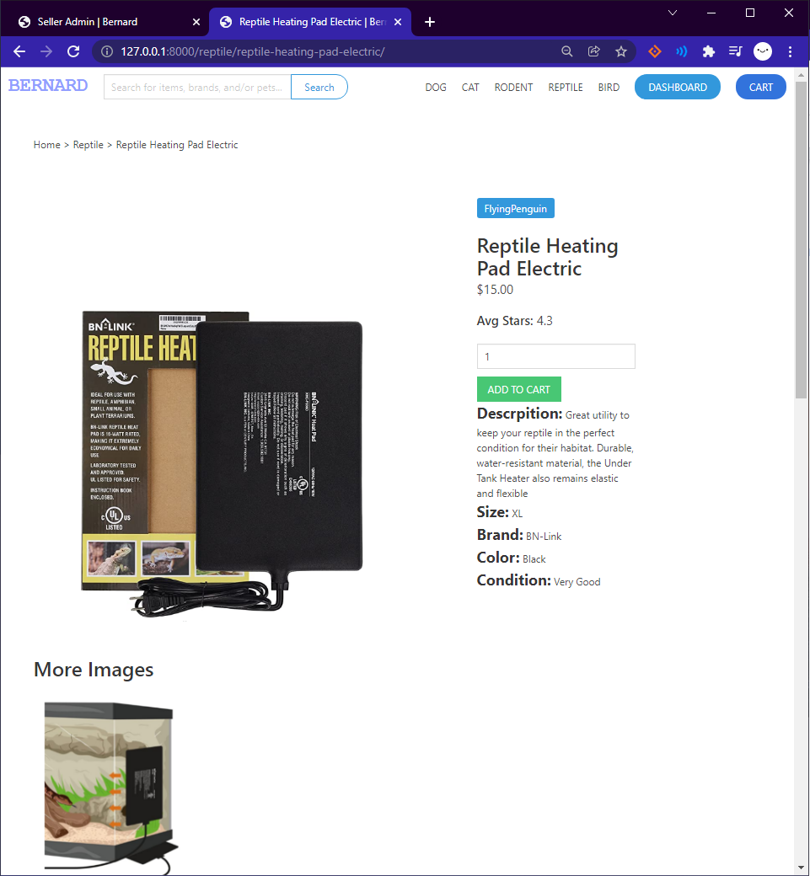
Context of Use and Technology
Context:
Users looking to sell/buy clothing and toy products for domestic animals
Users who would typically sell/buy their clothing items online
Users who are trying to rid of unused items
Technology:
Django site Admin Interface
Point of Sales integration with Stripe
Photo Collection
Form Based Interface
Internet Connection
Notes:
The context of use and technology.
The context is the conditions under which the website application will be used when:
The technology used to engage the user are the:
Form Based Interface - for logging information to display,
Users can fill out all of the form entries to insert a new data or certain entries that are required, in this case the Database

Slide 5









“
PERSONALITY
BIO
“I love being creative and that what drives me to be the best for my business and my pets longevity”
Jessica has been a local boutique owner in Seattle for the past 10 years. She focuses mostly on knitted hats and arrangements of coats, but has started to focus on dog and cat clothing as well. She has recently started posting her clothing products she created and does wear on Depop, and her sales has rocketed in the past year. Being a pet owner herself she loves to focus on giving her pets the best life possible and is seeking ways to better their environments and other animals alike.
On her off time, Jessica enjoys going to local shops and finding unique and hard to find items that you can't find on the internet.
“
Enthusiastic
Encouraging
Independent
Knowledgeable
Helpful
Behavior
Tech Savviness
Business Skills
Sociable
Motivations
Ambition
Jessica Andrew
Personal Business
Growth
Visually Driven
Socializing
Pet
35, Seattle
Influences
Goals
Frustrations
· Pinterest
· Tiktok
· Animal Youtube
· Current Events
· Animals
· National Geo.
^{· Status}
^{Single}
^{· Job Title}
Local Boutique Owner
^{· Income}
^{$75K}
^{· ARCHETYPE}
^{The Entrepreneur}
Growing and expanding boutique towards animal focused clothing
Self-improvement, especially outside of work
Spend more time with pets
Cost of living is high, and trying to tend to animals can be difficult
Cultivating animal loving communities is hard w/o direct
Obtaining animal products takes a lot of effort
Frequently used apps
Instagram
Depop
Pinterest
Notes:
Here is one of the Top Target Personas which fall under the Pet Owners/ Enthusiasts Shoppers. this persona, Likes shopping in versatile marketplace for animals especially looking for items at a mark down or finding unique creations by merchants. They also frequently go online shopping for personal clothing as well as for their animal. They also are Domestic animal owner, which would fit in categorically as dogs, cats, ferrets, rodents, and birds. They are a Free market enthusiast and They like to look for items that are created by individual merchants that can be found online

Slide 6
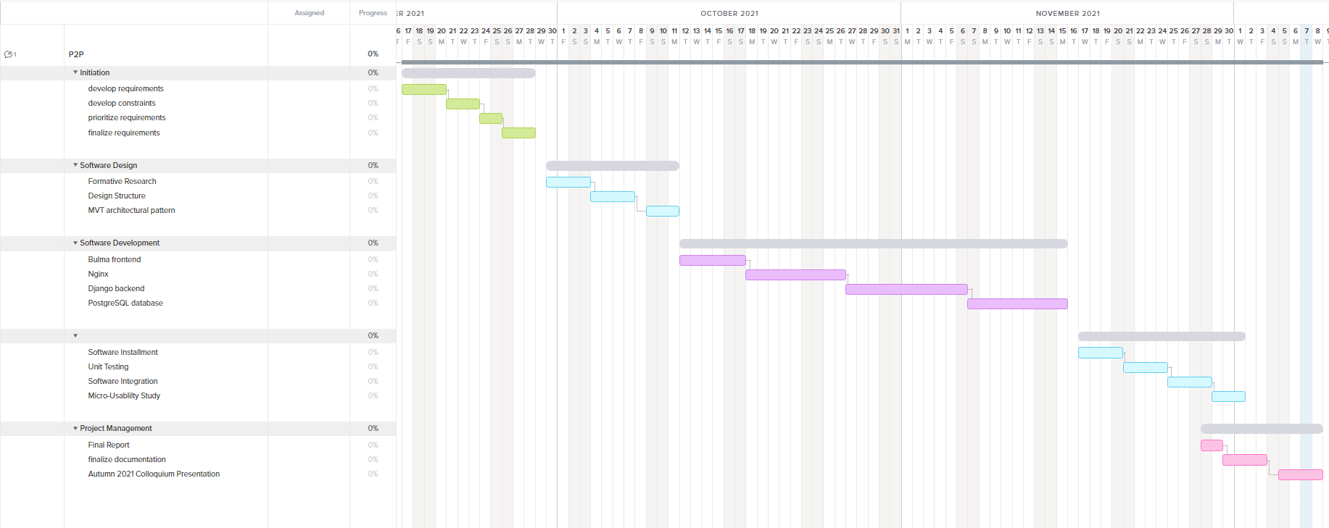
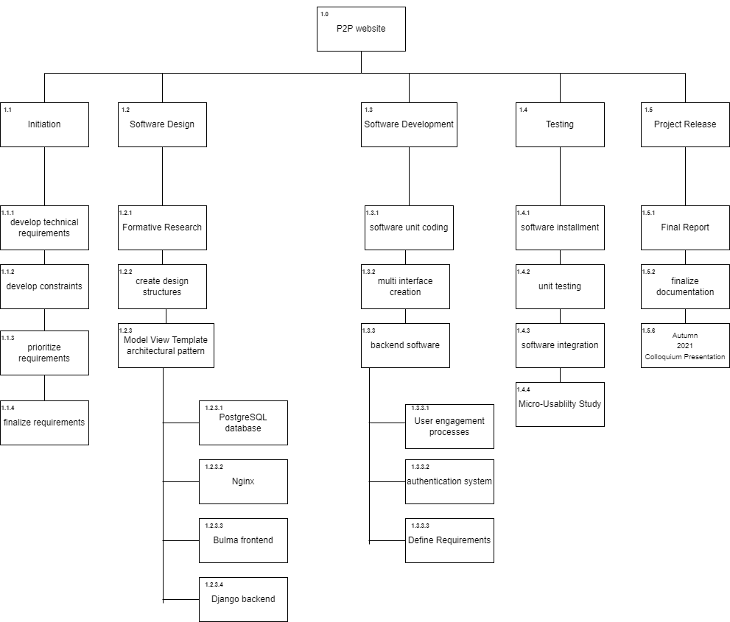
Planning
Goals:
Build web application that supports, maintains, and allows for users to engage with a marketplace
Maintain the schedule set to establish the release of the project
Use design principles to implement a functional website
Build a web application that allows buyers and sellers to trade among each other
Scope:
Determine time estimate for details of the project
Design the user and system interaction
~ 2 months to build project
2 Sprints divided into:
Seller, Items, Admin
Buyer, Carts, Orders

Slide 7
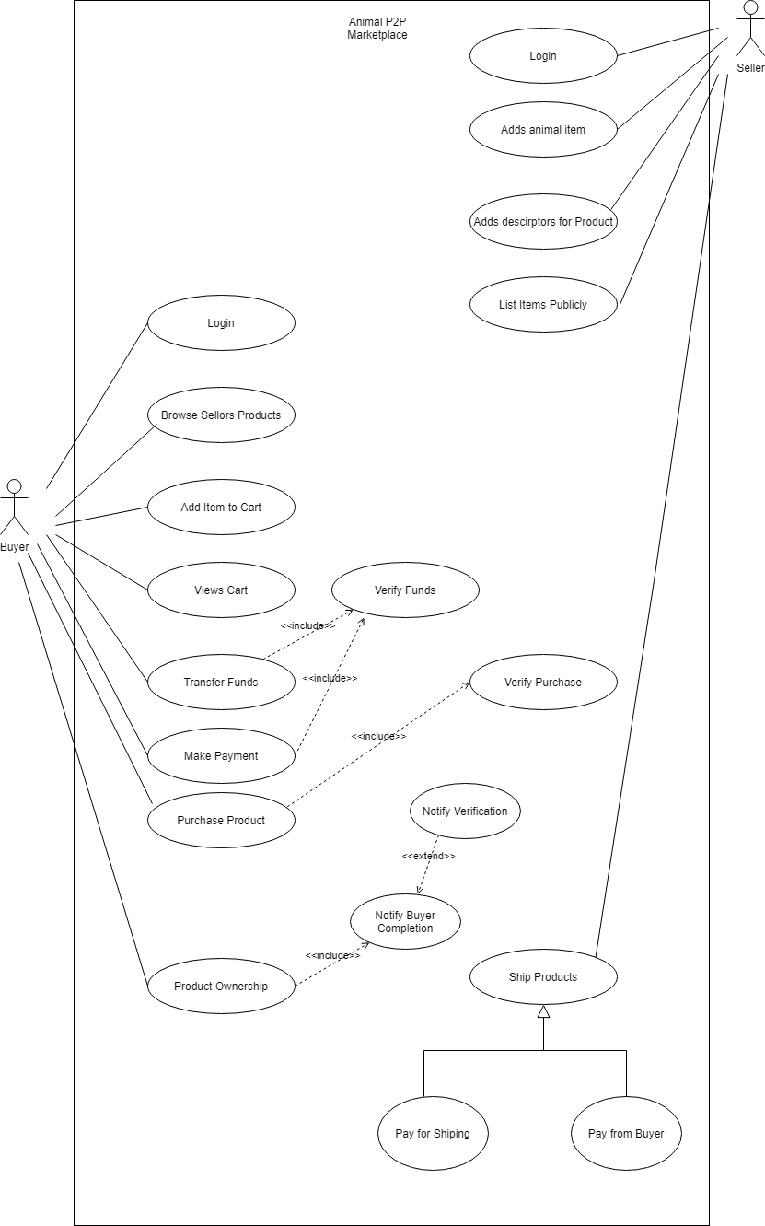
Deliverables
Project time estimate
Work breakdown structure
Risk and market analysis
Personas
Micro usability testings
Reports
Design documents
Domain Model
Use Case Texts
Scenarios
Use Case Diagram
Robustness Diagrams
Sequence Diagrams
Class Diagram
Project codebase
Poster
Presentation

Slide 8
Demo

Slide 9

Reflections
Highlights
Fulfilled Deliverable requirements
Practice Agile SDLC methodology
Website development using Django
Improvements
Apply Business Models for revenue generation and competitive strategies
Expand Application boundaries to allow direct buyer/seller interactions on site
Port the web application into a mobile application

Slide 10
Thank you
Notes:
I also want to give my acknowledgement to my faculty advisor Prof Lund my Sponsors Prof Kochanski and Prof Asuncion (aa · soon · syown), and Ms. McDaniel. They have all been instrumental in my
Learning progression and capstone. This is the end of my Presentation. Thank you and are there any questions.

